Slide 1
Why Visio and Power BI together?

Slide 2

Bring data to life and gain valuable insights about your business using Power BI
Connect to your data
Build powerful dashboards
Share and collaborate with others
Secure, real-time connections to data on-premises and in the cloud
Gain quick insights from pre-built dashboards and reports
Securely share reports through curated content library approach
Secure and trusted data exploration tool
Protect sensitive data in the cloud with first-class security from Microsoft
Notes:
Power BI is a cloud-based analytics service that provides faster time to insight by enabling you to visualize, explore, and extract insights from data. It brings together data from diverse sources to deliver rich, comprehensive views of business operations. With Power BI, you can see all of your data in a single view, and create an analytics environment in minutes to monitor data and share reports. Live dashboards and reports show visualizations and KPIs from data that reside both on-premises and in the cloud, providing a consolidated view across your business regardless of where your data lives.

Slide 3
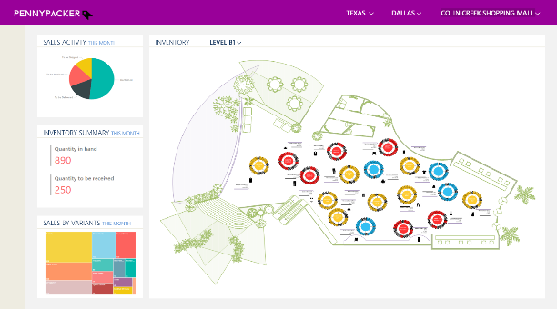
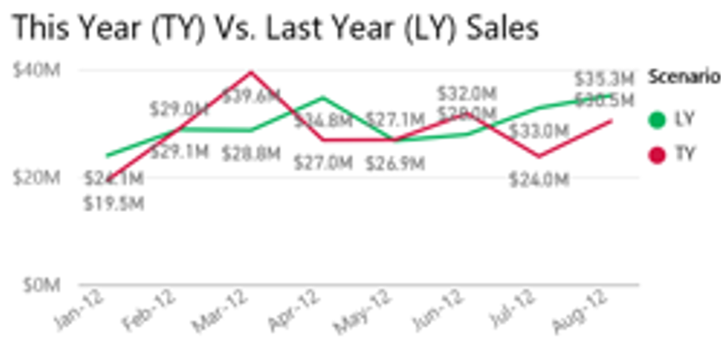
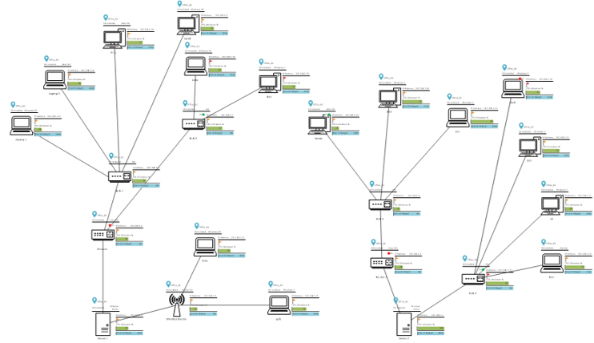
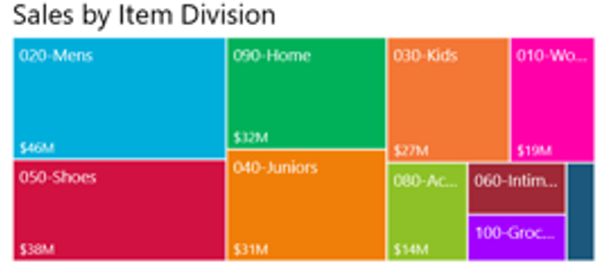

Monitoring unified dashboards
Real-world context
KPI
Real world Visualization
See the full picture with unified dashboards
Operational intelligence
Business intelligence
Interconnections
Analysis
Sequence
Goal

Slide 4
Visio Visual reports demo
Shakun Grover

Slide 5
Creating Unified Dashboards

Slide 6





Demo
1
2
3
4
5
Create Visio diagram
Import to Power BI
Map Power BI data to Visio shapes
Define interactions with data and shapes
Share the dashboard

Slide 7

Demo
Insert Visio Visual into a report
Auto-zoom setting
Change diagram link
Copy diagram link

Slide 8






Examples of unified dashboards
Inventory Management
Organizational Performance
Root Cause Analysis (Fishbone)
Facility Monitoring
Business Process Modeling
Download Sample pbix from:
www.aka.ms/VisioVisualSampleDownload
Check it out:
www.aka.ms/VisioVisualPlayground

Slide 9
Quick links
Contact us at:
tellvisio@microsoft.com
Experience the power of Visio Visuals at:
www.aka.ms/VisioVisualPlayground
Need help getting started:
www.aka.ms/VisioVisualHelp
Leave feedback at:
www.aka.ms/VisioVisualFeedback

